Slide 1
You should be in your assigned seat at start of period!!
Items turned in the last 2 days:
Unit 3 Warm-Ups
Unit 3 Review
10/4/13 -- warm-up 1: what are the steps of the scientific method?

Slide 2
Physical Science Monday 10/14/13
Warm-Up #2
What is potential energy?
What is kinetic energy?

Slide 3
Physical Science Tuesday 10/15/13
Warm-Up #3
Is work done if you hold a box over your head for 20 min? Why?
Reminder: retest Wednesday over matching items from Unit 3 Work, Power and Mechanical advantage.

Slide 4
Wednesday 10/16
Testing Day did not see all periods

Slide 5
Thursday 10/17
Warm-up 4
How high is a rock with a mass of 0.15 g and 24.5 J of energy?

Slide 6
Friday 10/18
Warm-up 5
Define: Law of conservation of energy

Slide 7
Monday 10/21
Warm-up 6
A 13.5 kg box has a mechanical energy of 661.5 is dropped. What is the Kinetic energy when the box is 1.25 m from the ground?
PE = mgh
KE= ½ m v²
ME = PE + KE

Slide 8
Tuesday 10/22
Warm-up 7
How much energy does a 2.5 kg object have traveling 22.5 m/s?

Slide 9
Wednesday 10/23
Warm-Up 8
Fill in the blanks with the correct type of energy.
Cars convert ___A___ to thermal and ____B___
An atomic bomb convers ___C__ to ___D__ and thermal.
Plants convert _____E___ to chemical.

Slide 10
Thursday 10/24
Log into computers and start Roller Coaster Lab

Slide 11
Friday 10/25
Review Ch 15 & 16 for quiz

Slide 12
Monday 10/28
Turn in Roller Coaster Lab and work on Energy and Heat booklet.

Slide 13
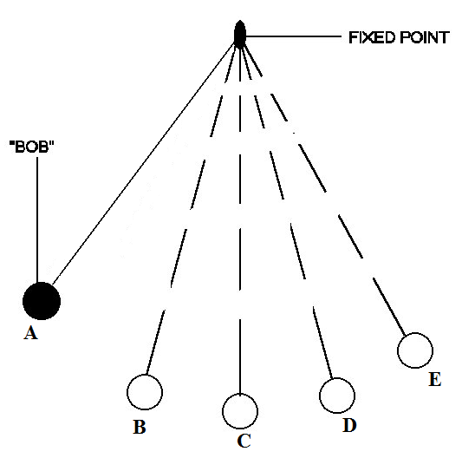
Tuesday 10/29
Warm-up 9
Where does the ball have the
Most KE
Most PE
V is increasing
V is decreasing

